Slide 1
Predictors of Incident and Persistent Internalizing Mental Disorders Among Ugandan Children and Adolescents Living With HIV: A Machine Learning Approach
Prepared By
Isaac Okello Opio
(PROGRESS REPORT)

Slide 2





CONCEPT OF THE STUDY
CHAKA study
368 cases vs 368 controls
Dr Dickens Akena
Dr. Kalungi Allan
Dr. Jjingo Daudi
Prof. E. Kinyanda
VULNERABILITY
Genetic
-SLC6A4
-TPH2
-FKBP5
-NR3C1
Biological
-Telomere length
-CD4 count
-HIV viral load
-WHO HIV clinical stage
Psychosocial
-Stress
-Social support
-Sociodemographic
PREDICTION: MACHINE LEARNING
Emotional disorders outcomes at 12 months
Source: Own source

Slide 3

STUDY AIMS
Aim 1
Build a machine learning model for prediction of incident and persistent cases of emotional disorders
Aim 2
Evaluate performance of the model for each of genetic, biological and psychosocial factors respectively
Aim 3
Evaluate performance of the model which includes all the three factor domains of genetic, biological and psychosocial factors

Slide 4
METHOD
01
02
03
Data Cleaning & Feature engineering
Choose algorithm (DT, RF, LR, SVM)
Identify data
05
04
Model Deployment
Train, Validate & Test the model
Source: https://slidesgo.com/

Slide 5
Machine Learning Model Development
Prerequisite
Dataset, Python (v3.11.5) and packages (Pandas), ML framework (Scikit Learn) etc.
Step 1: Data Splitting
Step 2: Model Building (Objective 1)
Supervised ML techniques
Decision trees, random forests, logistic regression, and support vector machines from Scikit Learn
Step 3: Model Evaluation (Objective 2)
The metrics (accuracy, precision, recall, and F1 score).
Step 4: Model Integration (Objective 3)
A model using all the three predictors (genetic, biological, and psychosocial factors) will be constructed.
Step 5: Predictions
Prediction on unseen data and feature importance.

Slide 6
THE MACHINE LEARNING PIPELINE
1. Prepare Problem
a) Load libraries
b) Load dataset
2. Summarize Data
a) Descriptive statistics
b) Data visualizations
3. Prepare Data
a) Data Cleaning
b) Feature Selection
c) Data Transforms
4. Evaluate Algorithms
a) Split-out validation dataset
b) Spot Check Algorithms and compare metrics (F1 was used to choose best model)
5. Improve Accuracy
a) Algorithm Tuning (hyper parameter tuning)
6. Finalize Model
a) Predictions on validation dataset
b) Feature importance selection

Slide 7
INCIDENT IMD
Definition: Newly occurring internalizing mental disorder (mood & emotional disorders like anxiety, depression, ptsd) on individuals who never had at the baseline.

Slide 8
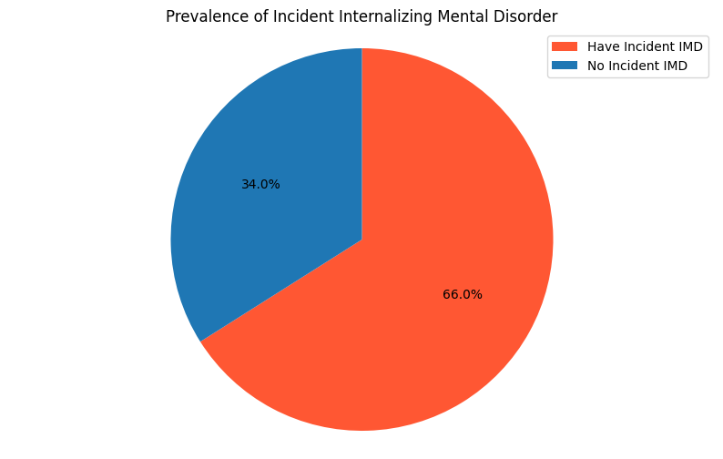
RESULTS/METHOD FOR INCIDENT IMD
Target
The prevalence of Incident IMD was 66.0% (243/368)
Descriptive statistics
Data Size
Variables = 29
Sample size = 368
Number of duplicates
= 0

Slide 9
RESULTS/METHOD FOR INCIDENT IMD
Tables showing the participant profiles
Variables | Categories | Frequency | Percentage
Age Category | 13-17 | 105 | 28.53
 | 5-8 | 133 | 36.14
 | 9-12 | 130 | 35.33
Sex | Male | 182 | 49.46
 | Female | 186 | 50.54
Child Education Level | No formal education | 4 | 1.09
 | Pre-primary | 325 | 88.80
 | Secondary level | 37 | 10.11
Religion | Christians | 287 | 77.99
 | Muslim | 80 | 21.74
 | Others | 1 | 0.27
BMI Category | Underweight | 294 | 80.11
 | Normal weight | 59 | 16.08
 | Overweight | 10 | 2.72
 | Obesity | 4 | 1.09
Variables | Categories | Frequency | Percentage
Worst HIV Clinical Stage | Stage 1 | 68 | 18.48
 | Stage 2 | 195 | 52.99
 | Stage 3 | 99 | 26.90
 | Stage 4 | 6 | 1.63
Recent stress | Mild stress | 125 | 33.97
 | Moderate stress | 109 | 29.62
 | Severe stress | 134 | 36.41
CD4 Category | Normal CD4 range | 38 | 10.38
 | Possibly immune compromised | 31 | 8.47
 | Advanced immune compromised | 297 | 81.15
Viral load | Undetectable | 126 | 41.72
 | Suppressed | 108 | 35.76
 | Unsuppressed | 68 | 22.52
Telomere Length Change | Decreased | 308 | 83.70
 | Increased | 60 | 16.30
Variables | Categories | Frequency | Percentage
stin2vntr | 10/10 | 26 | 7.62
 | 10/12 | 126 | 36.95
 | 12/12 | 189 | 55.43
httlpr1 | LL | 223 | 62.29
 | LS | 115 | 32.12
 | SS | 20 | 5.59
HTTLPRrs35531 | LA/LA | 130 | 37.46
 | LA/LG | 76 | 21.90
 | LA/SA | 79 | 22.77
 | LA/SG | 2 | 0.58
 | LG/LG | 12 | 3.46
 | SA/LG | 30 | 8.65
 | SA/SA | 18 | 5.19

Slide 10
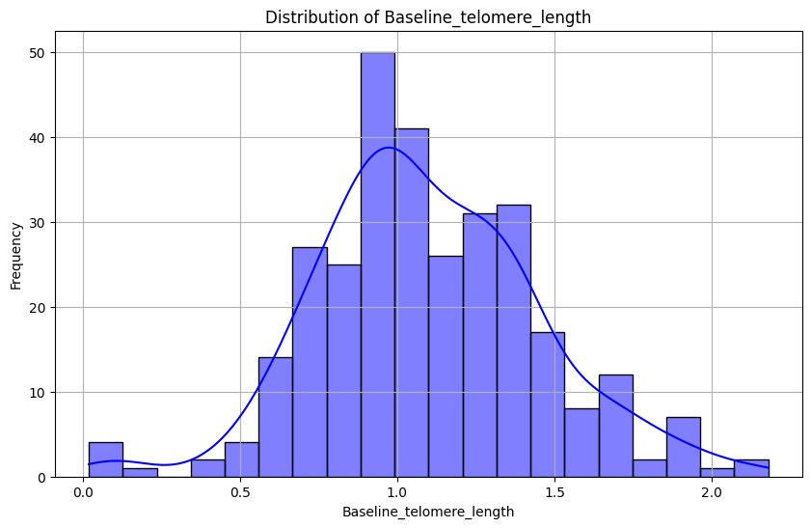
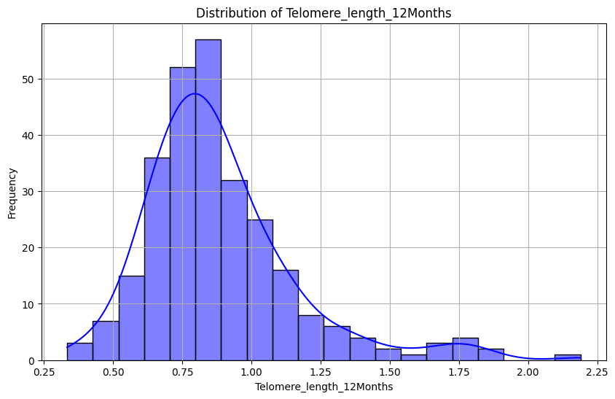
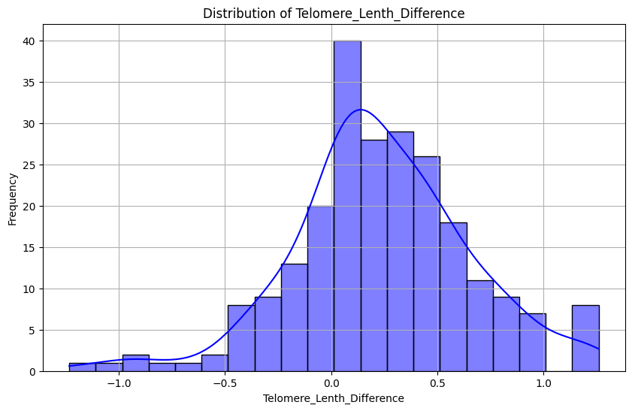
RESULTS/METHOD FOR INCIDENT IMD
Distribution of the data
The numerical data were slightly skewed.
Handling missing values
Categorical variables: Mode
Numerical variables: Mean
Figure 1: Plot for numerical data

Slide 11
RESULTS/METHOD FOR INCIDENT IMD
Profile Report before imputations
Missing cells = 698
Missing cells (%) = 6.5%
Variable types
Categorical = 27
Numeric = 3
Alerts (22)
Imbalanced data
Missing values
Profile Report after imputations
Missing cells = 0
Missing cells (%) = 0%
Variable types
Categorical = 26
Numeric = 3
Alerts (12)
Imbalanced data
High correlation

Slide 12
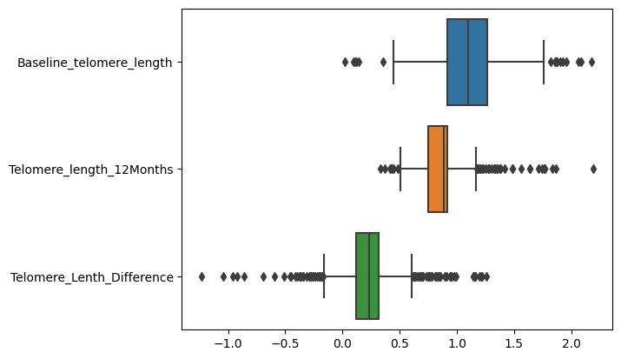
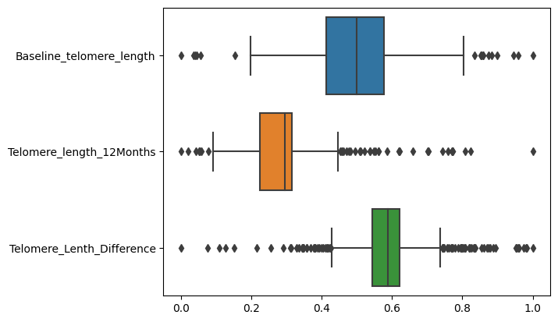
TRANSFORMATIONS FOR INCIDENT IMD
Label encoding (LabelEncoder) categorical variables
Scaling (MinMaxScaler) of numerical data to limit outliers
Before scaling
After scaling

Slide 13
SINGLE PREDICTORS
PSYCHOSOCIAL FACTORS

Slide 14
MODEL SPOT-CHECKING FOR INCIDENT IMD
Using F1 Score, the best model at spot check was AdaBoost (66.7%)
Classifier | F1 Score | Precision | Recall | Accuracy | ROC AUC
Logistic Regression | 0.665 | 0.691 | 0.697 | 0.697 | 0.691
Gaussian Naive Bayes | 0.541 | 0.616 | 0.531 | 0.531 | 0.618
K-Nearest Neighbors | 0.626 | 0.627 | 0.632 | 0.632 | 0.618
Decision Tree | 0.553 | 0.570 | 0.550 | 0.567 | 0.553
Support Vector Classifier | 0.594 | 0.627 | 0.673 | 0.673 | 0.690
Random Forest | 0.621 | 0.635 | 0.636 | 0.625 | 0.612
Gradient Boosting | 0.656 | 0.662 | 0.683 | 0.683 | 0.670
AdaBoost | 0.667 | 0.679 | 0.693 | 0.693 | 0.659
Linear Discriminant Analysis | 0.658 | 0.681 | 0.686 | 0.686 | 0.693
Table: Performance of the model in the analysis during spot checking.

Slide 15
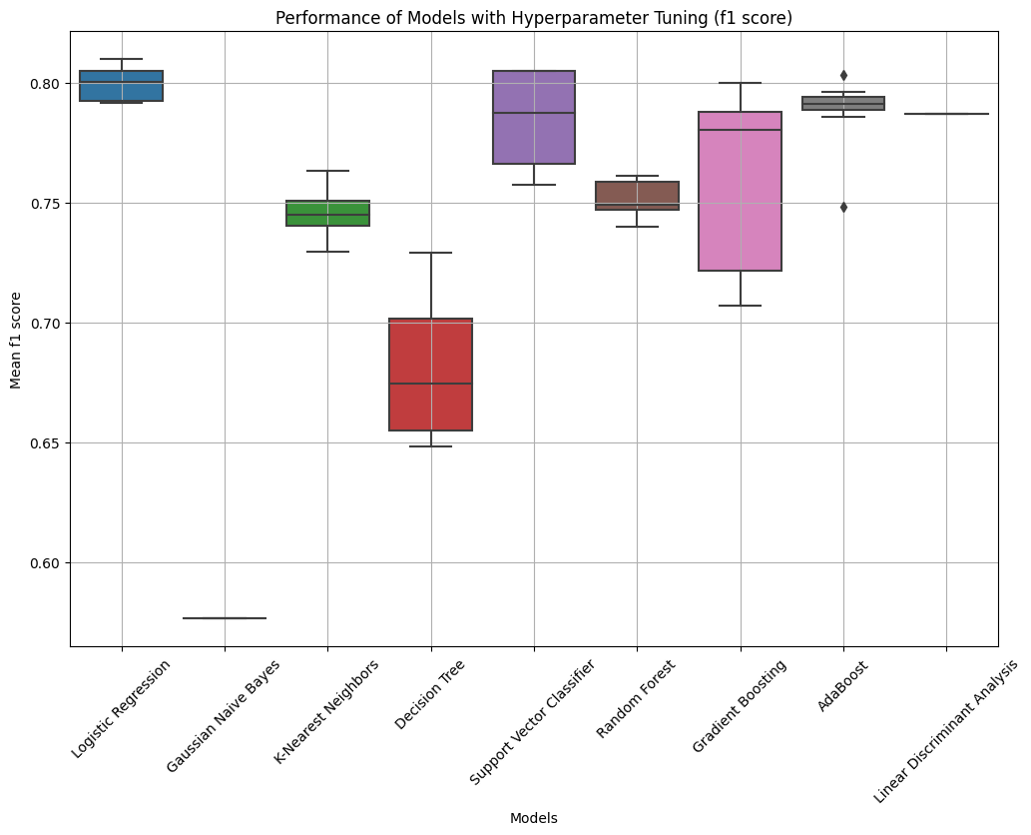
IMPROVING ACCURACY FOR INCIDENT IMD
After hyper parameter tuning:
Best Model: Logistic Regression (F1 Score= 80.96%, Accuracy =70.03%)
Table: Model performance after hyper parameter tuning

Slide 16
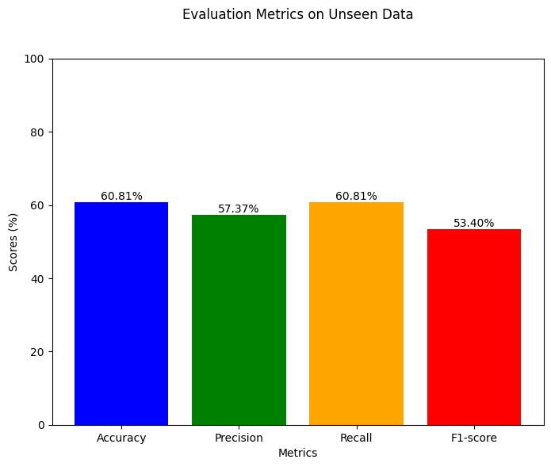
PERFORMANCE OF BEST MODEL
Logistic Regression (Best Model) performance on unseen data (test data) was:
Accuracy: 60.81%
Precision: 57.37%
Recall: 60.81%
F1-score: 53.40%
This indicates a moderate performance.

Slide 17
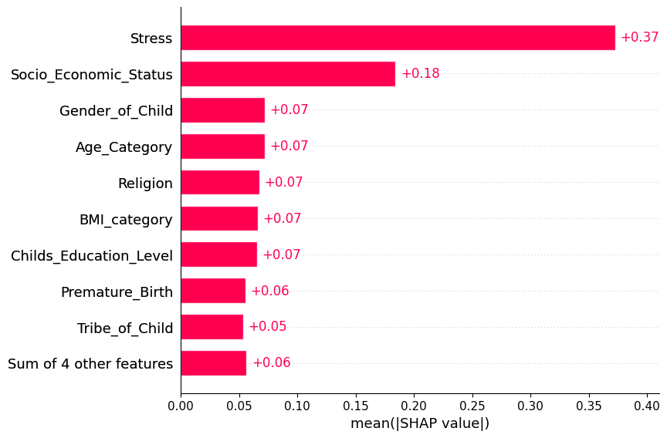
FEATURE IMPORTANCE FOR INCIDENT IMD
Conclusion: the most important Psychosocial predictors of Incident IMD are; Stress and Socio-economic Status
Note: The SHAP plot is a tool for understanding the contribution of individual features to a specific prediction.
STATA |  | Machine Learning |  | Agreement
Variable/Feature | P Value | Feature | Importance
Stress | 0.000 | Stress | 0.077 | Yes
Socioeconomic status | 0.009 | Socioeconomic status | 0.030 | Yes
Table: The performance of Machine Learning Model Vs STATA Software

Slide 18
SINGLE PREDICTORS
BIOLOGICAL FACTORS

Slide 19
MODEL SPOT-CHECKING FOR INCIDENT IMD
Using F1 Score, the best model at spot check was KNeighbors Classifier (63.5%)
Classifier | F1 Score | Precision | Recall | Accuracy | ROC AUC
KNeighbors Classifier | 0.635 | 0.641 | 0.667 | 0.667 | 0.578
Decision Tree Classifier | 0.625 | 0.614 | 0.674 | 0.674 | 0.596
Random Forest Classifier | 0.624 | 0.624 | 0.681 | 0.694 | 0.597
Gradient Boosting Classifier | 0.609 | 0.611 | 0.677 | 0.677 | 0.559
GaussianNB | 0.600 | 0.614 | 0.656 | 0.656 | 0.557
Linear Discriminant Analysis | 0.565 | 0.568 | 0.677 | 0.677 | 0.568
Logistic Regression | 0.554 | 0.521 | 0.674 | 0.674 | 0.571
AdaBoost Classifier | 0.553 | 0.515 | 0.663 | 0.663 | 0.542
SVC | 0.552 | 0.519 | 0.670 | 0.670 | 0.533
Table: Performance of the model in the analysis during spot checking.

Slide 20
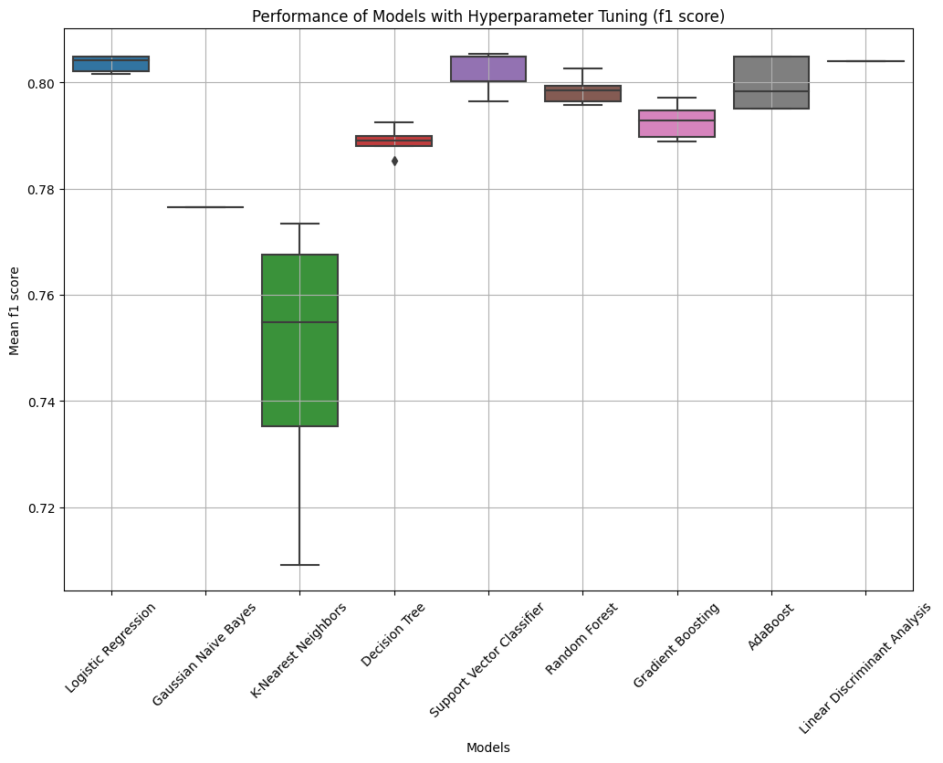
IMPROVING ACCURACY FOR INCIDENT IMD
After hyper parameter tuning:
Best Model: Support Vector Classifier (F1 Score= 80.53%, Accuracy =69.09%)
Table: Model performance after hyper parameter tuning

Slide 21
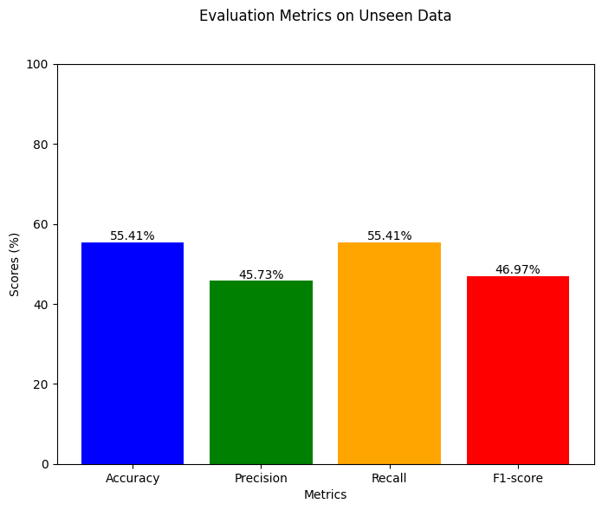
PERFORMANCE OF BEST MODEL
Support Vector Classifier (Best Model) performance on unseen data (test data) was:
Accuracy: 55.41%
Precision: 45.73%
Recall: 55.41%
F1-score: 46.97%
This indicates a moderate performance.

Slide 22
FEATURE IMPORTANCE FOR INCIDENT IMD
Not Applicable
There was no best plots that could show feature importance for the Support Vector Classifier chosen in this step.

Slide 23
SINGLE PREDICTORS
GENETIC FACTORS

Slide 24
MODEL SPOT-CHECKING FOR INCIDENT IMD
Using F1 Score, the best model at spot check was AdaBoost Classifier (59.8%)
Classifier | F1 Score | Precision | Recall | Accuracy | ROC AUC
AdaBoostClassifier | 0.598 | 0.607 | 0.653 | 0.653 | 0.591
GaussianNB | 0.589 | 0.589 | 0.650 | 0.650 | 0.552
KNeighborsClassifier | 0.582 | 0.573 | 0.615 | 0.615 | 0.523
GradientBoostingClassifier | 0.580 | 0.586 | 0.626 | 0.626 | 0.496
LinearDiscriminantAnalysis | 0.562 | 0.553 | 0.639 | 0.639 | 0.538
LogisticRegression | 0.554 | 0.538 | 0.650 | 0.650 | 0.545
SVC | 0.536 | 0.482 | 0.650 | 0.650 | 0.429
RandomForestClassifier | 0.532 | 0.505 | 0.561 | 0.547 | 0.472
DecisionTreeClassifier | 0.518 | 0.512 | 0.520 | 0.513 | 0.470
Table: Performance of the model in the analysis during spot checking.

Slide 25
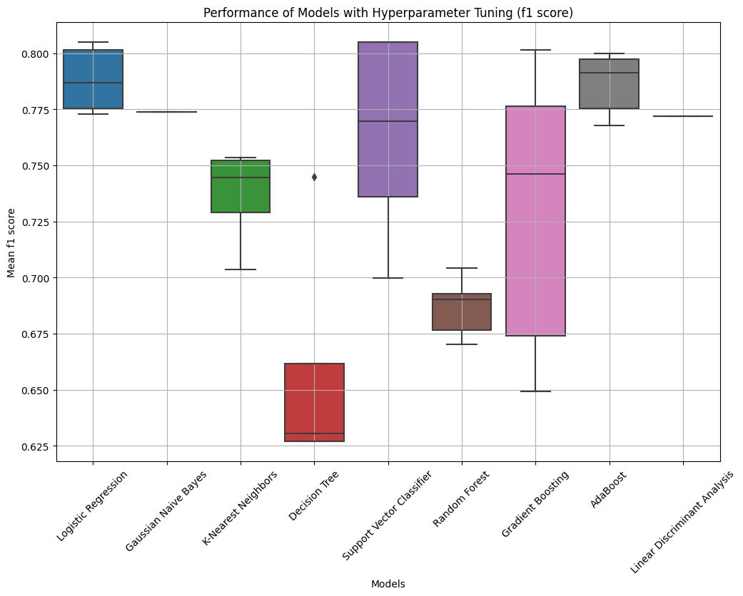
IMPROVING ACCURACY FOR INCIDENT IMD
After hyper parameter tuning:
Best Model: Logistic Regression (F1 Score= 80.49%, Accuracy =67.36%)
Table: Model performance after hyper parameter tuning

Slide 26
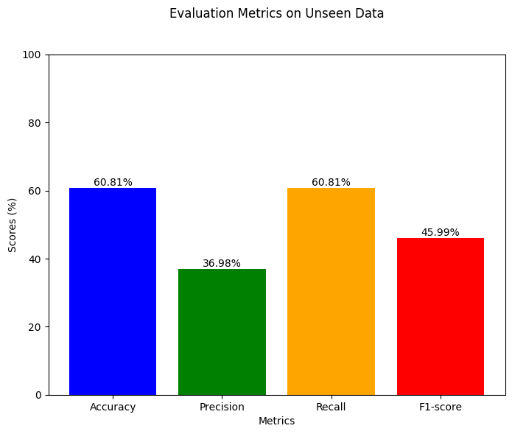
PERFORMANCE OF BEST MODEL
Logistic Regression (Best Model) performance on unseen data (test data) was:
Accuracy: 60.81%
Precision: 36.98%
Recall: 60.81%
F1-score: 45.99%
This indicates a moderate performance.

Slide 27
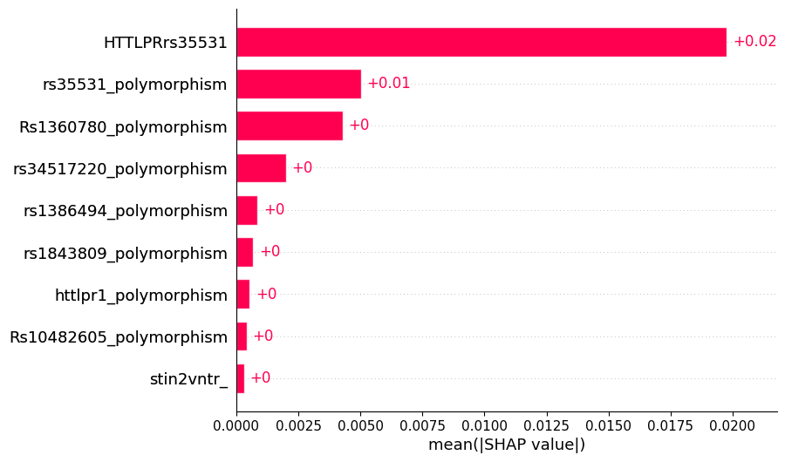
FEATURE IMPORTANCE FOR INCIDENT IMD
Conclusion:
The most important genetic predictors of Incident IMD are:
HTTLPRrs35531, and rs35531 polymorphisms
Variable | STATA | Machine Learning |  | Agreement
Variable/Feature | P Value | Feature | Importance
rs35531 | 0.029 | rs35531 | 0.034 | Yes
Rs1360780 | 0.095 | Rs1360780 | 0.034 | Yes
HTTLPRrs35531 | 0.177 | HTTLPRrs35531 | 0.045 | Yes
Table: The performance of Machine Learning Model Vs STATA Software

Slide 28
MULTIPLE PREDICTORS
PSYCHOSOCIAL, BIOLOGICAL AND GENETIC PREDICTORS

Slide 29
MODEL SPOT-CHECKING FOR INCIDENT IMD
Using F1 Score, the best model at spot check was Random Forest Classifier (68.3%)
Classifier | F1 Score | Precision | Recall | Accuracy | ROC AUC
Random Forest Classifier | 0.683 | 0.715 | 0.731 | 0.718 | 0.6674
Linear Discriminant Analysis | 0.676 | 0.678 | 0.697 | 0.697 | 0.648
Gradient Boosting Classifier | 0.660 | 0.658 | 0.677 | 0.680 | 0.643
Logistic Regression | 0.650 | 0.649 | 0.673 | 0.673 | 0.658
Ada Boost Classifier | 0.633 | 0.636 | 0.643 | 0.643 | 0.577
Kneighbors Classifier | 0.626 | 0.622 | 0.657 | 0.657 | 0.616
Decision Tree Classifier | 0.603 | 0.624 | 0.582 | 0.606 | 0.571
GaussianNB | 0.588 | 0.624 | 0.579 | 0.579 | 0.591
SVC | 0.577 | 0.621 | 0.680 | 0.680 | 0.646
Table: Performance of the model in the analysis during spot checking.

Slide 30
IMPROVING ACCURACY FOR INCIDENT IMD
Hyperparameter tuning
Used to optimize the performance of machine learning models by searching for the best set of hyperparameters.
Hyperparameters are settings that are not learned from the data but are set prior to training.
E.g: Regularization strength in logistic regression, the depth of a decision tree, or the number of trees in a random forest.

Slide 31
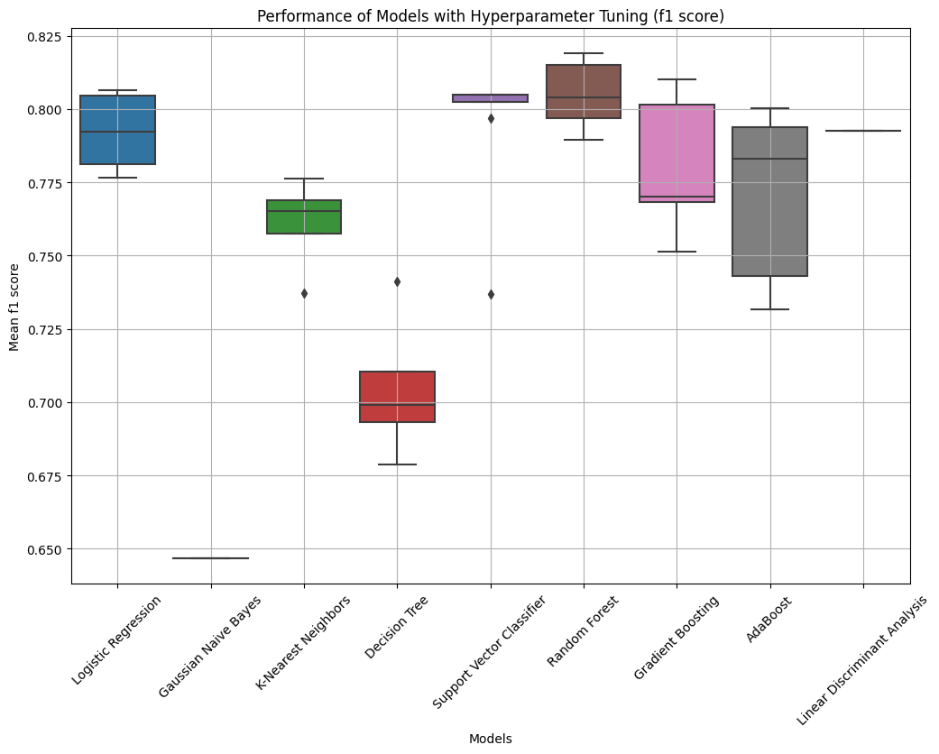
IMPROVING ACCURACY FOR INCIDENT IMD
Best Model: Random Forest (81.7%)
Model | F1 Score | Accuracy
Random Forest | 0.817 | 0.731
Gradient Boosting | 0.810 | 0.711
Logistic Regression | 0.806 | 0.697
Support Vector Classifier | 0.805 | 0.674
AdaBoost | 0.800 | 0.697
Linear Discriminant Analysis | 0.793 | 0.690
K-Nearest Neighbors | 0.776 | 0.653
Decision Tree | 0.737 | 0.629
Gaussian Naive Bayes | 0.639 | 0.568
Table: Model performance after hyper parameter tuning

Slide 32
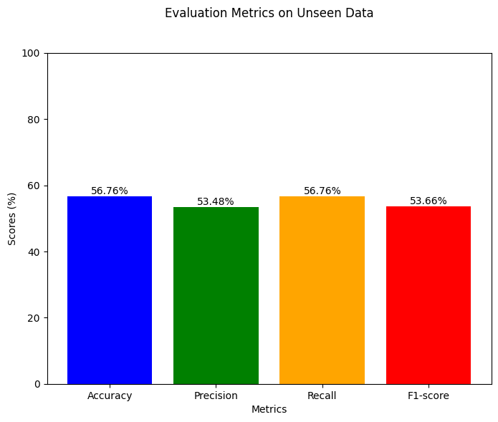
PERFORMANCE OF BEST MODEL
Random Forest (Best Model) performance on unseen data (test data) was:
Accuracy: 56.76%
Precision: 53.48%
Recall: 56.76%
F1-score: 53.66%
This indicates a moderate performance.

Slide 33
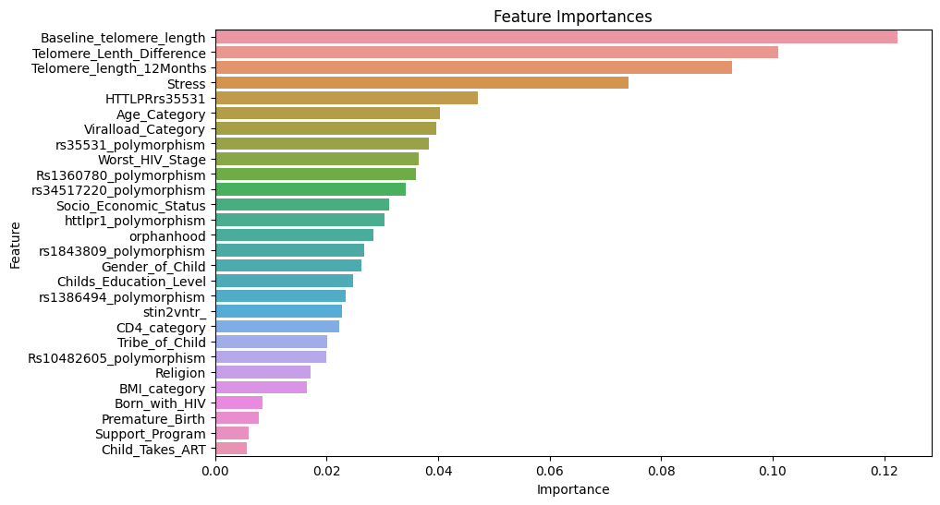
FEATURE IMPORTANCE FOR INCIDENT IMD
The important predictors of Incident IMD were:
Baseline telomere length, telomere length difference, telomere length change over 12 months, Stress, and HTTLPRrs35531 polymorphism

Slide 34
STATISTICAL TESTS Vs AI (INCIDENT IMD)
STATA |  |  | Machine Learning |  | Agreement
Variable/Feature | P Value |  | Feature | Importance
Baseline telomere length | n/a |  |  | 0.121 | n/a
Telomere_length_12Months | n/a |  |  | 0.099 | n/a
Telomere Length Difference | n/a |  |  | 0.096 | n/a
Stress | 0.000 |  | Stress | 0.077 | Yes
Education level |  |  | httplr1 | 0.030 | No
Socioeconomic status | 0.009 |  | Socioeconomic status | 0.030 | Yes
rs35531 | 0.029 |  | rs35531 | 0.034 | Yes
rs34517220 | 0.033 |  | rs34517220 | 0.038 | Yes
Rs1360780 | 0.095 |  | Rs1360780 | 0.034 | Yes
Religion | 0.147 |  | Worst_HIV_Stage | 0.040 | No
BMI Category | 0.152 |  | Age_Category | 0.034 | No
Viral load | 0.158 |  | Viral load | 0.045 | Yes
HTTLPRrs35531 | 0.177 |  | HTTLPRrs35531 | 0.045 | Yes
Total Agreement |  |  |  |  | =7/10 = 70%

Slide 35
DISCUSSION FOR INCIDENT IMD
Variable | Association with Mental Disorders
Worst HIV Stage | - Advanced clinical stages (e.g., WHO Stage III or IV) may involve a higher burden of physical symptoms and complications, causing anxiety and depression (Bartlett et al., 2019).
Viral Load | - High viral loads indicate uncontrolled HIV infection, leading to persistent stress and anxiety (Zielińska-Wieniawska et al., 2021b).
Socioeconomic Status | - Low SES are associated with increased stress, anxiety and depression (Lwidiko et al., 2018).
Orphanhood | - Heightened psychological distress and a lack of emotional support
Telomere Length | - Significantly shorter in patients with mental disorders (Kalungi, Womersley, et al., 2019).
Stress | - Psychological stress is linked to higher oxidative stress, lower telomerase activity, and shortened telomere length, contributing to biological aging in individuals with mental disorders
Age | - Older age is associated with shorter telomeres in individuals with mental disorders
rs34517220 (TPH2) | - The tryptophan hydroxylase gene (TPH) is associated with mental disorders, as it encodes an enzyme responsible for serotonin synthesis, crucial for mood regulation anxiety (Owalla et al., 2021).
Rs1360780 (FKBP5 Gene) | - Linked to the pathogenesis of psychiatric disorders, increasing vulnerability to stress-related anxiety and depression
HTTLPRrs35531 and rs35531 (SLC6A4) | - The serotonin transporter gene (SLC6A4) is critical for controlling serotonin levels and regulating mood and anxiety

Slide 36
CONCLUSION FOR INCIDENT IMD
The important predictors of Incident IMD were: Baseline telomere length, telomere length difference, telomere length change over 12 months, Stress, HTTLPR rs35531 variant, age category, viral load, rs35531 polymorphism, and the worst HIV stage ever experienced.
Combining the predictors (Psychosocial, biological and genetic predictors) improved the model performance.
The ML model’s performance was comparable to STATA Statistical Analysis Software (70% Agreement).
Recommendations:
There is need for a larger dataset to perform future model development, and improve performance.

Slide 37
PERSISTENT IMD
Definition: Enduring/ongoing internalizing mental disorder (mood & emotional disorders like anxiety, depression, ptsd) among individuals who had IMD at the baseline.

Slide 38
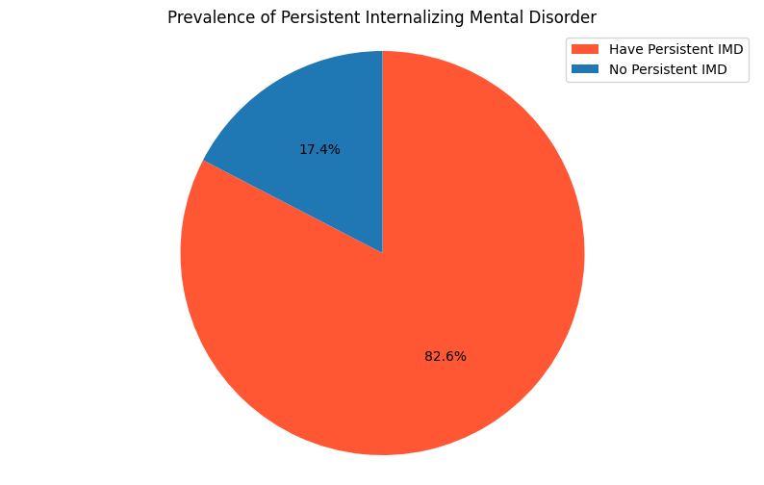
RESULTS/METHOD FOR PERSISTENT IMD
Target
The prevalence of Persistent IMD was 82.6% (304/368)
Descriptive statistics
Data Size
Variables = 29
Sample size = 368
Number of duplicates
= 0

Slide 39
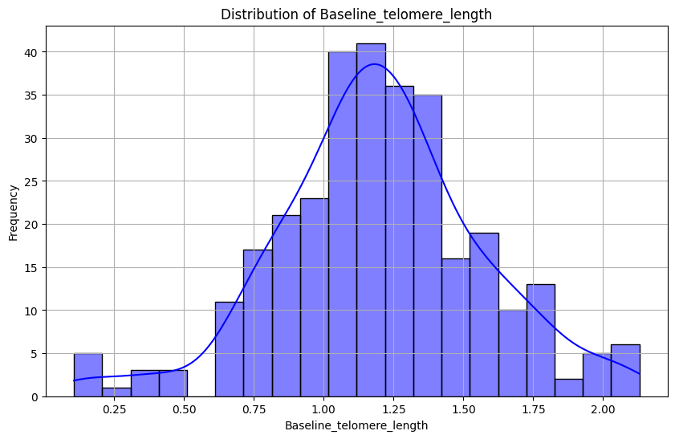
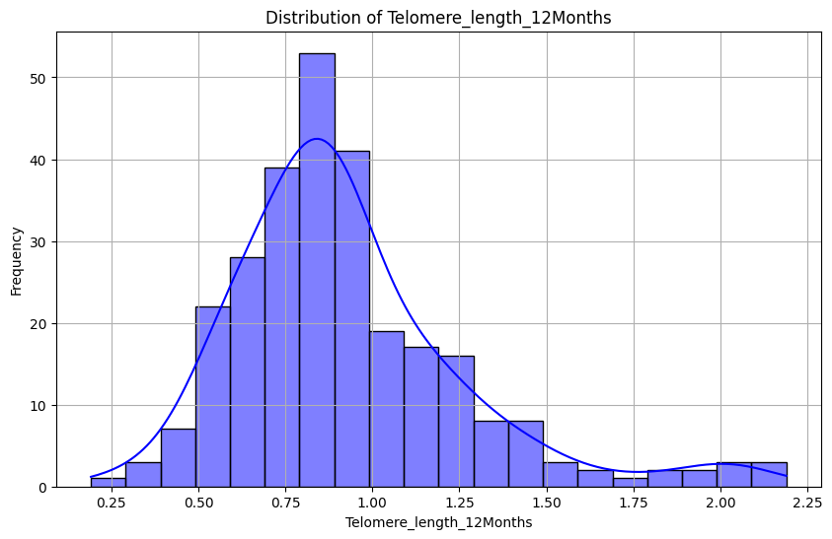
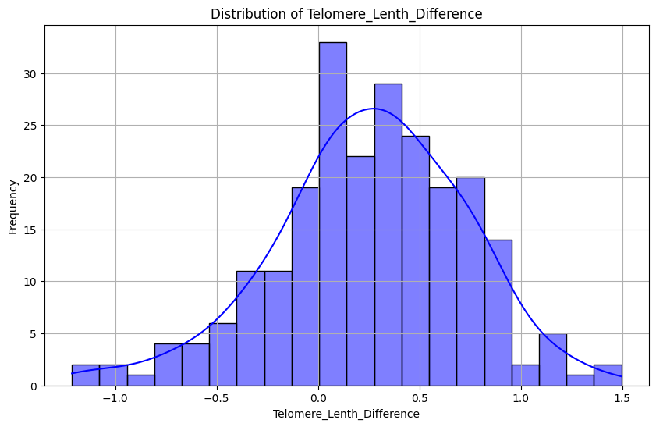
RESULTS/METHOD FOR PERSISTENT IMD
Distribution of the data
The was moderately skewed.
Handling missing values
Categorical variables: Mode
Numerical variables: Mean
Figure 1: Plot for numerical data

Slide 40
RESULTS/METHOD FOR PERSISTENT IMD
Profile Report before imputations
Missing cells = 579
Missing cells (%) = 5.4%
Variable types
Categorical = 27
Numeric = 2
Alerts (21)
Imbalanced data
Missing values
Profile Report after imputations
Missing cells = 0
Missing cells (%) = 0%
Variable types
Categorical = 26
Numeric = 3
Alerts (11)
Imbalanced data
High correlation
Zeros

Slide 41
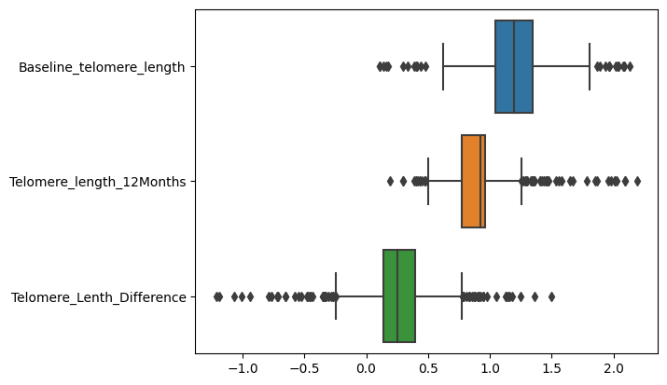
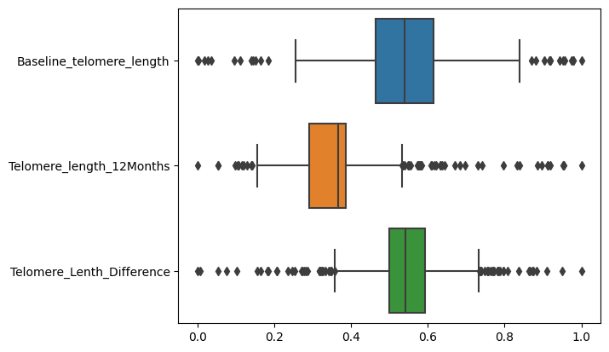
TRANSFORMATIONS FOR PERSISTENT IMD
Label encoding (LabelEncoder) categorical variables
Scaling (MinMaxScaler) of numerical data to limit outliers
Before scaling
After scaling

Slide 42
SINGLE PREDICTORS FOR PERSISTENT IMD
PSYCHOSOCIAL FACTORS

Slide 43
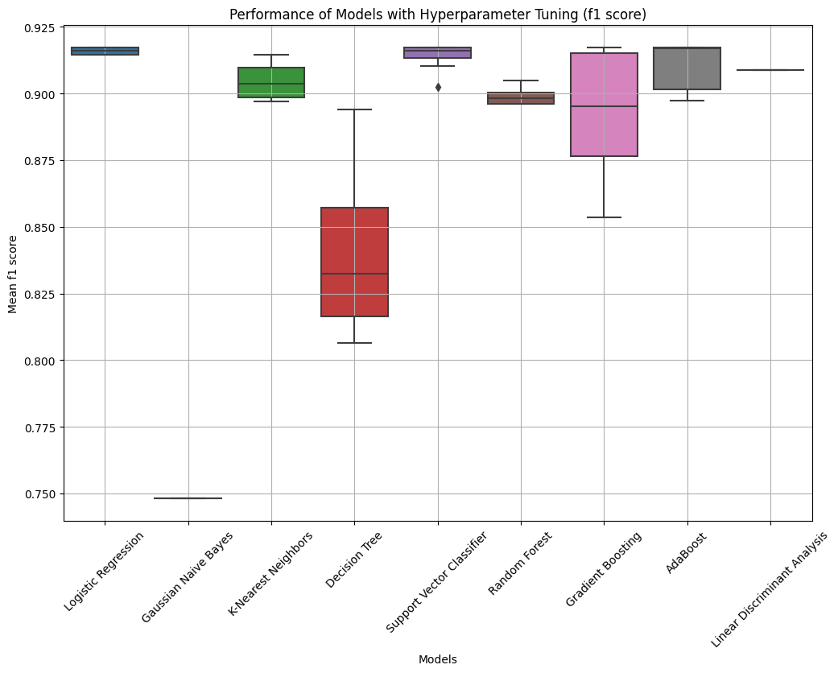
IMPROVING ACCURACY FOR PERSISTENT IMD
Before hyper parameter tuning (Model Spot Check):
Best Model: Random Forest Classifier (F1 Score= 78.26%, Accuracy =84.71%)
After hyper parameter tuning:
Best Model: Logistic Regression (F1 Score= 91.72%, Accuracy =84.71%)
Table: Model performance after hyper parameter tuning

Slide 44
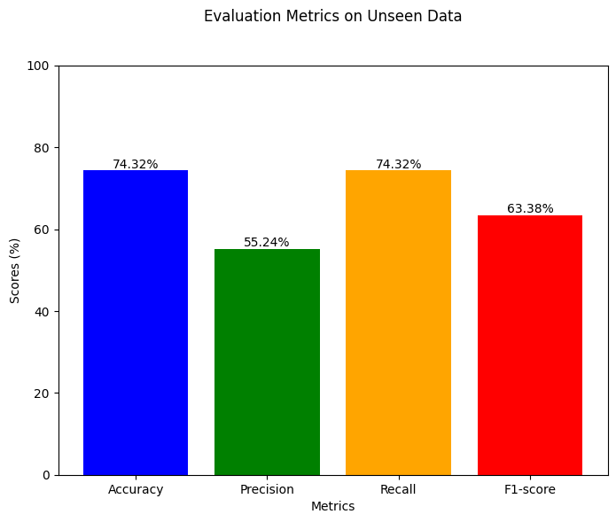
PERFORMANCE OF BEST MODEL
Logistic Regression (Best Model) performance on unseen data (test data) was:
Accuracy: 74.32%
Precision: 55.24%
Recall: 74.32%
F1-score: 63.38%
This indicates a high performance.

Slide 45
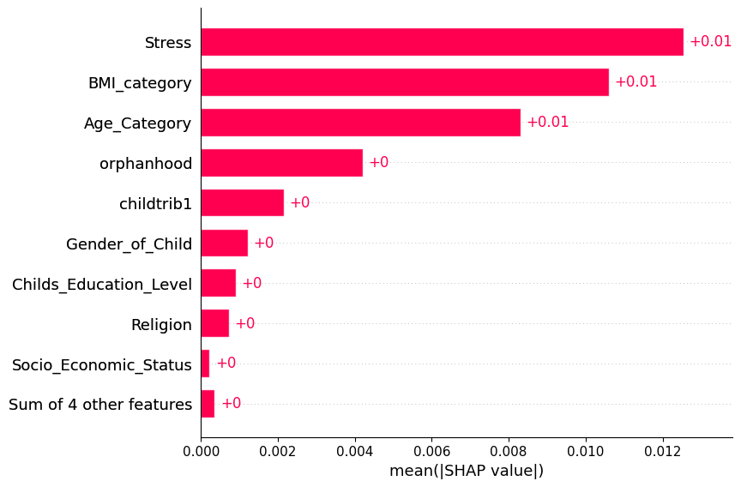
FEATURE IMPORTANCE FOR PERSISTENT IMD
Conclusion: The most important Psychosocial predictors of persistent IMD are; Stress, BMI, Age Category and Orphan hood
Variable | STATA | Machine Learning |  | Agreement
Variable/Feature | P Value | Feature | Importance
Stress | P<0.05 | Stress | 0.077 | Yes
Age category | P<0.05 | Age category | 0.031 | Yes
Education Level | P<0.05 |  | 0.038 | No
BMI Category | P<0.05 | BMI Category | 0.034 | Yes
Table: The performance of Machine Learning Model Vs STATA Software

Slide 46
SINGLE PREDICTORS
BIOLOGICAL FACTORS

Slide 47
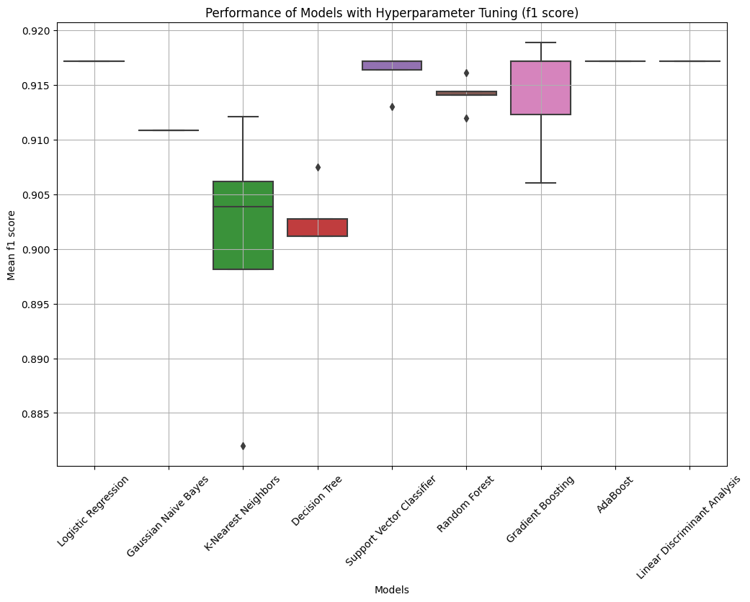
IMPROVING ACCURACY FOR PERSISTENT IMD
Before hyper parameter tuning (Model Spot Check):
Best Model: Gradient Boosting (F1 Score= 78.93%, Accuracy =85.03%)
After hyper parameter tuning:
Best Model: Gradient Boosting (F1 Score= 91.88%, Accuracy =85.05%)
Table: Model performance after hyper parameter tuning

Slide 48
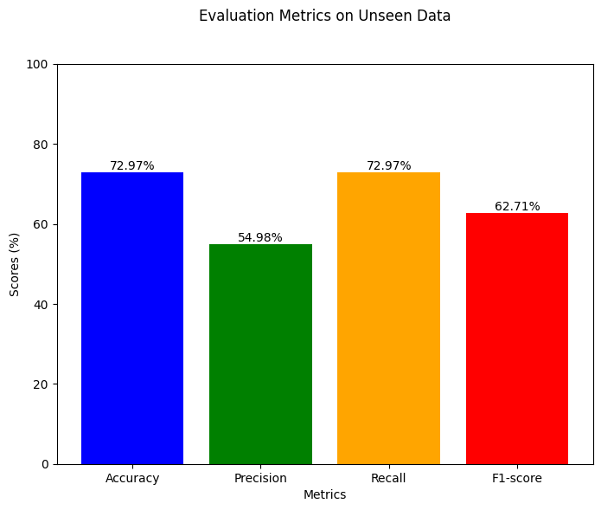
PERFORMANCE OF BEST MODEL
Gradient Boosting (Best Model) performance on unseen data (test data) was:
Accuracy: 72.97%
Precision: 54.98%
Recall: 72.97%
F1-score: 62.71%
This indicates a high performance.

Slide 49
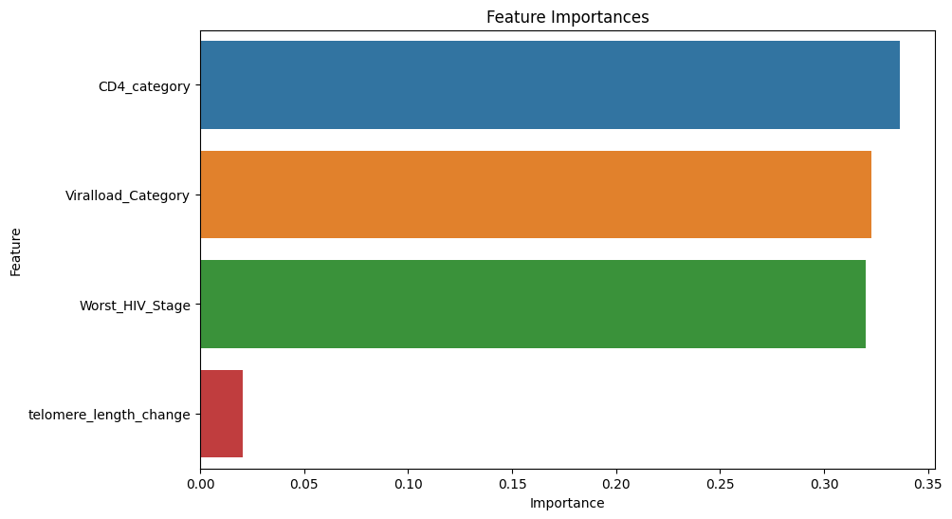
FEATURE IMPORTANCE FOR INCIDENT IMD
Note: There was no statistical agreement (with STATA)

Slide 50
SINGLE PREDICTORS
GENETIC FACTORS

Slide 51
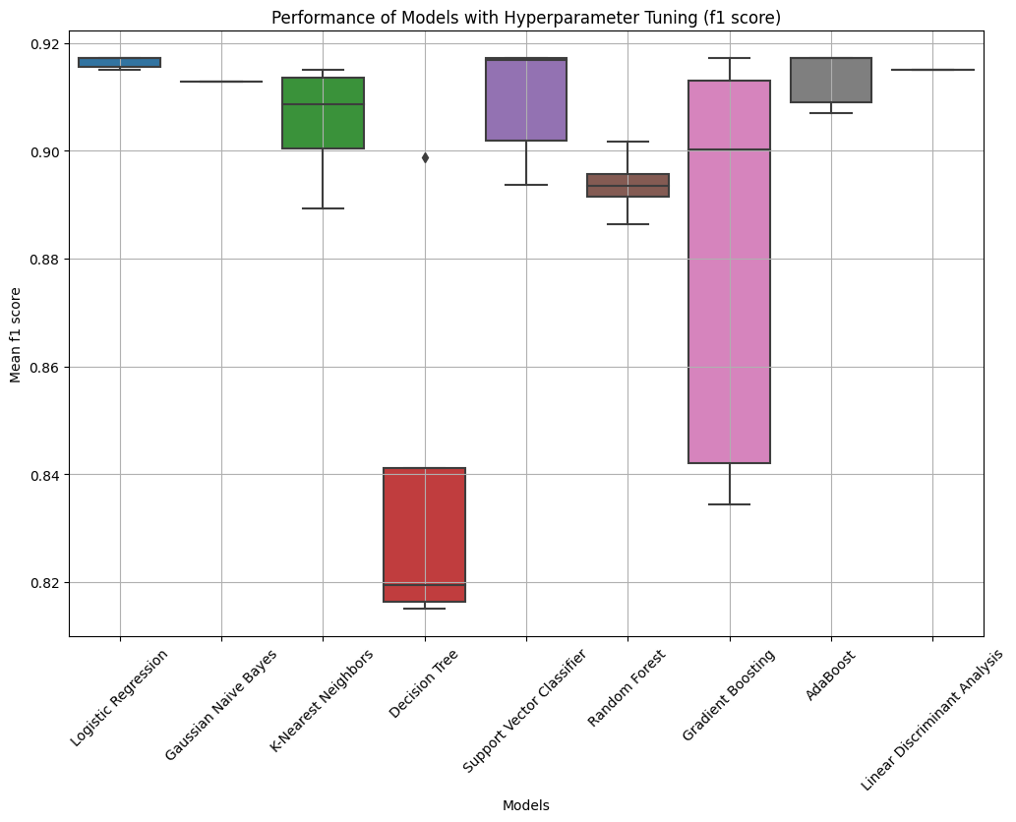
IMPROVING ACCURACY FOR PERSISTENT IMD
Before hyper parameter tuning (Model Spot Check):
Best Model: Gaussian Naive Bayes (F1 Score= 77.92%, Accuracy =84.05%)
After hyper parameter tuning:
Best Model: Logistic Regression (F1 Score= 91.72%, Accuracy =84.71%)
Table: Model performance after hyper parameter tuning

Slide 52
PERFORMANCE OF BEST MODEL
Logistic Regression (Best Model) performance on unseen data (test data) was:
Accuracy: 74.32%
Precision: 55.24%
Recall: 74.32%
F1-score: 63.38%
This indicates a high performance.

Slide 53
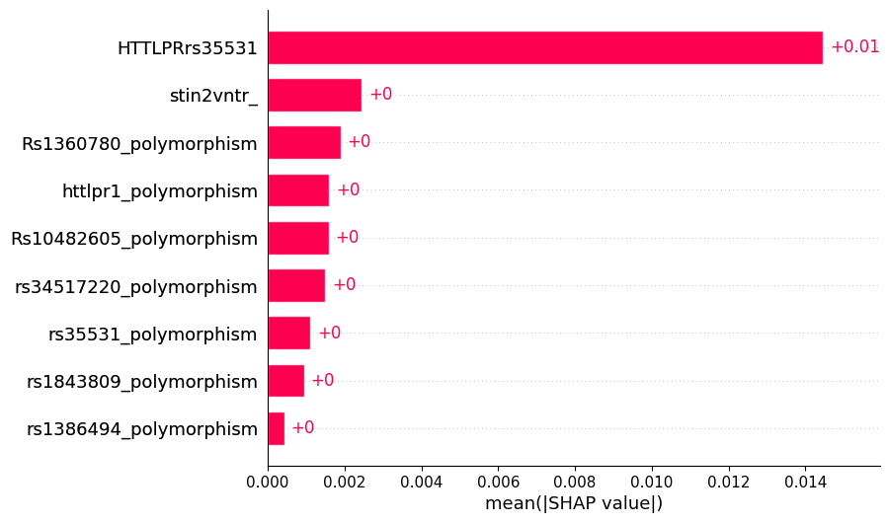
FEATURE IMPORTANCE FOR PERSISTENT IMD
Conclusion: The most important genetic predictor of persistent IMD is:
HTTLPRrs35531 polymorphisms
Note: There was no statistical agreement

Slide 54
MULTIPLE PREDICTORS
PSYCHOSOCIAL, BIOLOGICAL AND GENETIC PREDICTORS

Slide 55
MODEL SPOT-CHECKING FOR PERSISTENT IMD
Using F1 Score, the best model at spot check was Gradient Boosting Classifier (78.9%)
Classifier | F1 Score | Precision | Recall | Accuracy | ROC AUC
GradientBoostingClassifier | 0.789 | 0.763 | 0.833 | 0.837 | 0.673
KNeighborsClassifier | 0.787 | 0.761 | 0.827 | 0.827 | 0.595
SVC | 0.777 | 0.718 | 0.847 | 0.847 | 0.637
RandomForestClassifier | 0.774 | 0.717 | 0.837 | 0.840 | 0.677
AdaBoostClassifier | 0.767 | 0.746 | 0.793 | 0.793 | 0.592
LogisticRegression | 0.765 | 0.715 | 0.823 | 0.823 | 0.643
LinearDiscriminantAnalysis | 0.754 | 0.712 | 0.803 | 0.803 | 0.610
DecisionTreeClassifier | 0.747 | 0.755 | 0.748 | 0.731 | 0.517
GaussianNB | 0.661 | 0.738 | 0.655 | 0.655 | 0.555
Table: Performance of the model in the analysis during spot checking.

Slide 56
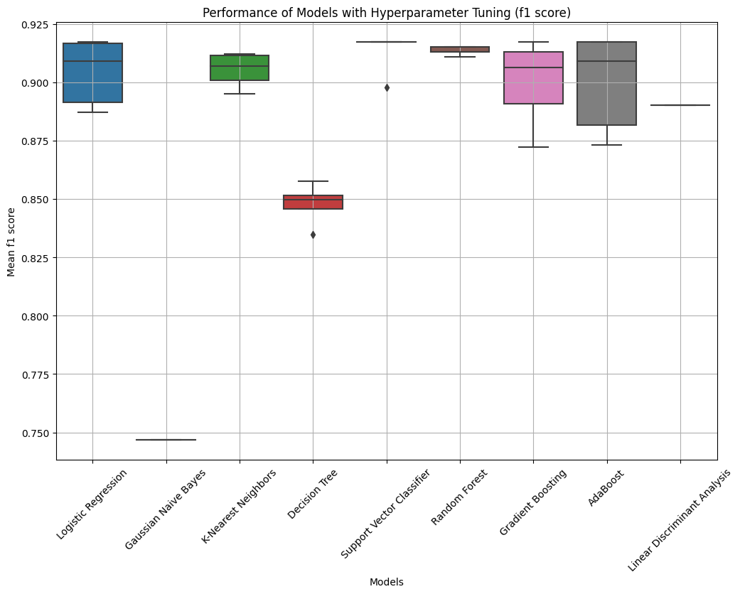
IMPROVING ACCURACY FOR PERSISTENT IMD
Best Model: Logistic Regression (91.7%)
Classifier | Accuracy (Original) | Accuracy (Updated)
Logistic Regression | 0.917 | 0.847
Support Vector Classifier | 0.917 | 0.847
Gradient Boosting | 0.917 | 0.847
AdaBoost | 0.917 | 0.847
Random Forest | 0.915 | 0.844
K-Nearest Neighbors | 0.912 | 0.840
Linear Discriminant Analysis | 0.890 | 0.803
Decision Tree | 0.851 | 0.751
Gaussian Naive Bayes | 0.747 | 0.655
Table: Model performance after hyper parameter tuning

Slide 57
PERFORMANCE OF BEST MODEL
Logistic Regression (Best Model) performance on unseen data was:
Accuracy: 74.32%
Precision: 55.24%
Recall: 74.32%
F1-score: 63.38%
This a high (more than average) performance.

Slide 58
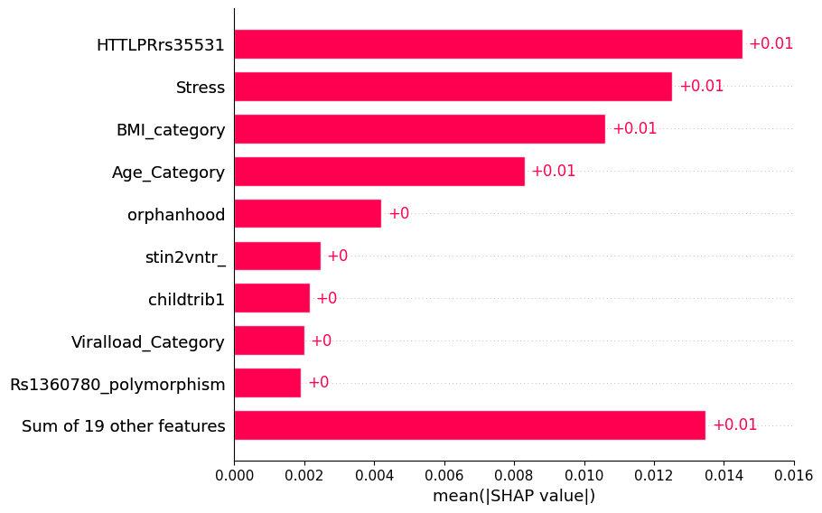
FEATURE IMPORTANCE FOR PERSISTENT IMD
Feature importance: features with the most impact on a model's predictions.
For Persistent IMD, the most important predictors were;
1. HTTLPRrs35531 polymorphism
2. Stress
3. BMI
4. Age
5. Orphan hood

Slide 59
STATISTICAL TESTS Vs AI (PERSITENCE IMD)
Variable | STATA | Machine Learning |  | Agreement
Variable/Feature | P Value | Feature | Importance
Stress | P<0.05 | Stress | 0.077 | Yes
Age category | P<0.05 | Age category | 0.031 | Yes
Education Level | P<0.05 |  | 0.038 | No
BMI Category | P<0.05 | BMI Category | 0.034 | Yes
 |  | HTTLPRrs35531 | 0.045 | No
Total Agreement |  |  |  | =3/5 = 60%

Slide 60
CONCLUSION FOR PERSISTENT IMD
The most important predictors for persistent IMD were: HTTLPRrs35531 polymorphism, Stress, BMI, Age and Orphans hood.
The best ML model for predicting persistent IMD IS Logistic Regression (91.7% F1 Score i.e. better precision [accuracy] and recall [sensitivity]).
Inclusion of all predictors (psychosocial, biological and genetic) did not improve the model performance.
Recommendations:
There is need for a larger dataset to perform future model development, and improve performance.

Slide 61
OVERALL STUDY LIMITATIONS
High prevalence of missing values might have compromise the model reliability.
Imputation methods used (mode for categorical, mean for numerical) might have introduced biases.
Low sample size (n=368 for each case) raises concerns of under fitting, limiting model generalizability.

Slide 62
OVERALL STUDY CONCLUSION
The project is scalable to include other psychiatric conditions.
Machine learning models performed better in predicting persistent IMD than incident IMD.
Inclusion of all predictors (psychosocial, biological and genetic) only improved the performce of the model for predicting incident IMD.

Slide 63
THE END

